Slide 1
Team Members:
Mohamed Ashraf
Ahmed Adel
Abdelaziz Shabib
Mohamed Khaled
Kirolos
Malak Amgad
Docker Foundations Recap
From VMs to Containers – A DevOps Journey
-
From VMs to Containers – A DevOps Journey

Slide 2

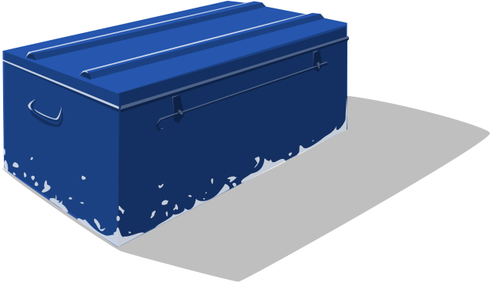

Virtual Machines vs. Containers
VMs: Full OS isolation, slower startup, heavier.
Containers: Shared kernel, lightweight, faster.
VMs for legacy apps; Containers for microservices.

Slide 3

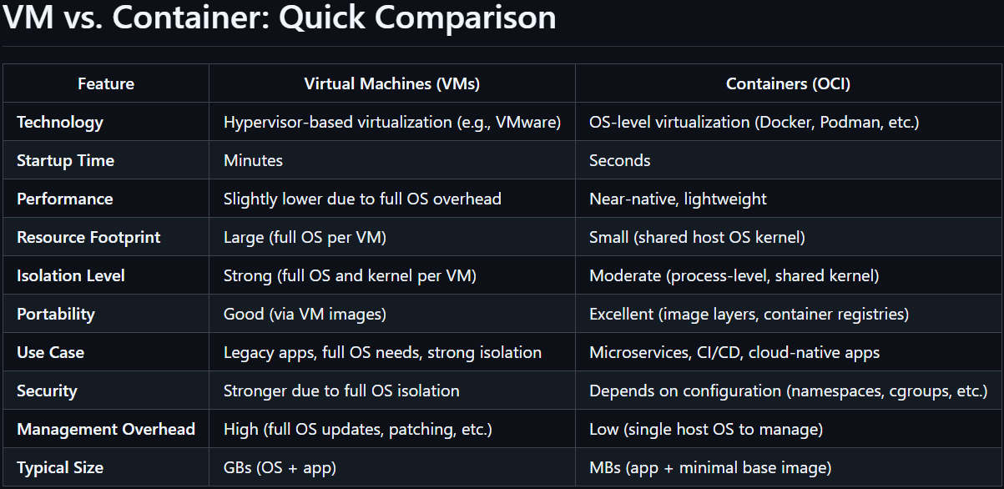
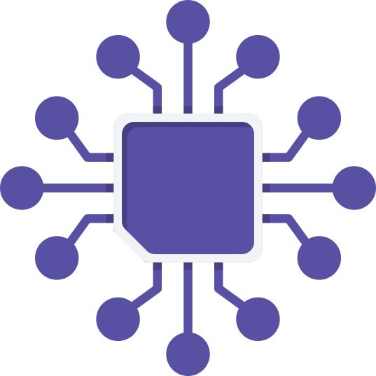


Slide 4

Namespaces isolate, cgroups limit.
Linux Namespaces
& cgroups
Namespaces: Isolate processes, networks, filesystems.
cgroups v2: Limit CPU/memory, unified hierarchy.

Slide 5


PID (Process ID): Isolates process trees.
NET (Network): Provides separate network interfaces, IP addresses, routing tables, etc.
MNT (Mount): Isolates filesystem mount points.
UTS (UNIX Timesharing System): Allows containers to have their own hostname and domain name.
IPC (Inter-Process Communication): Separates shared memory, semaphores, and message queues.
USER: Provides user and group ID mappings, allowing containers to run as "root" internally while being non-root on the host.

Slide 6

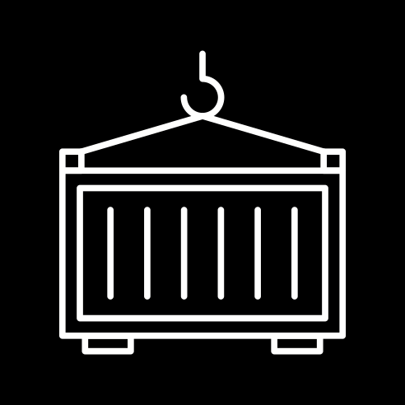


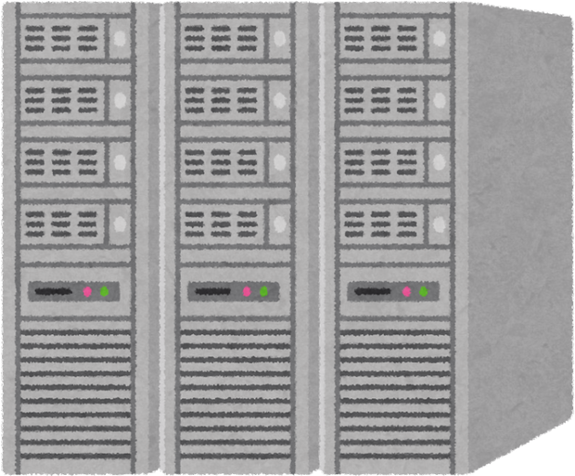

Docker Installation Daemon
&
client (CLI)
Server (dockerd)
Plugins (buildx, compose)
Client/Server: CLI vs. Engine (dockerd).
Storage: overlay2 driver.
Security: AppArmor, seccomp.

Slide 7
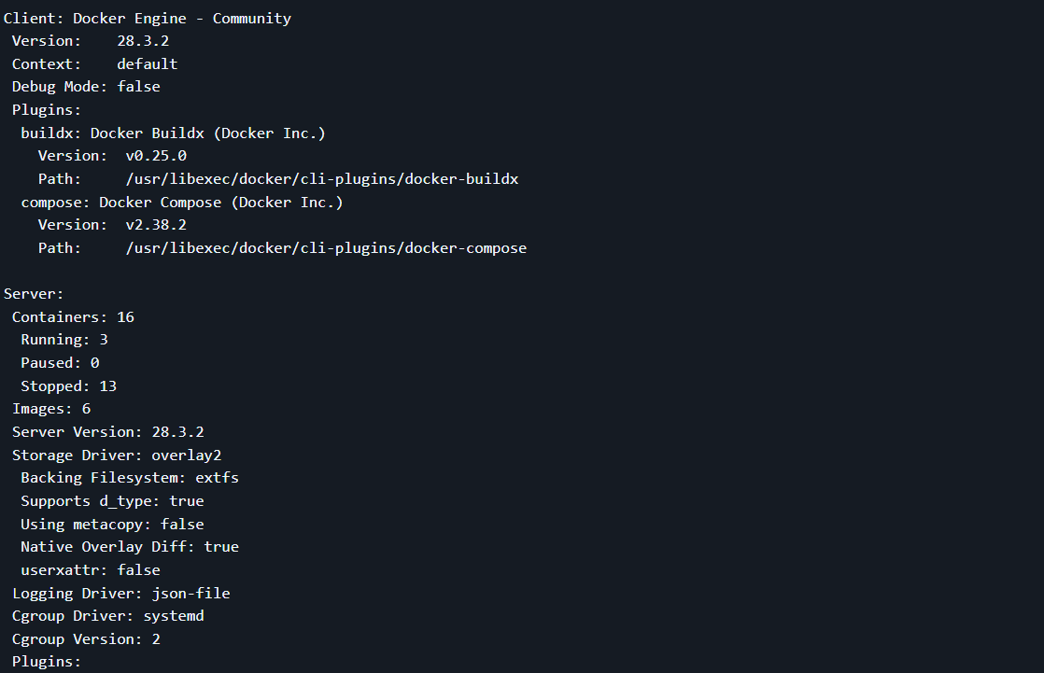
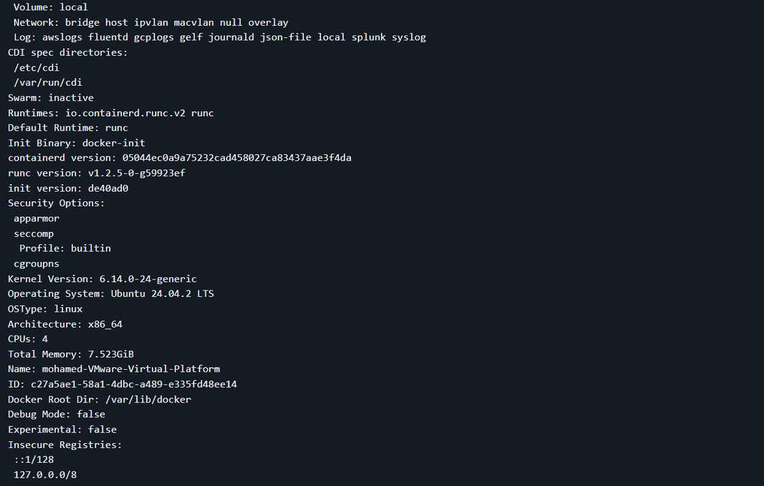
Raw Docker Info Output

Slide 8

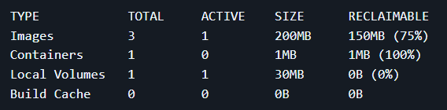
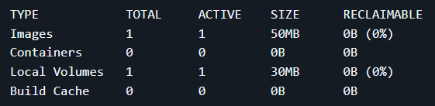

Running Your First Container
Check Disk Usage Before & After Pruning
--name: Assigns a container name.
-p: Maps host:container ports.

Slide 9


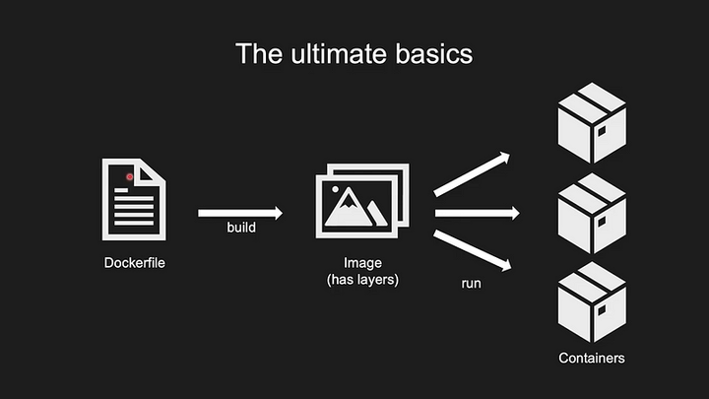
FROM alpine:latest
COPY run.sh /run.sh
ENTRYPOINT ["/run.sh"]
Dockerfile Basics
Use alpine for small images.
Chain RUN commands to reduce layers.

Slide 10

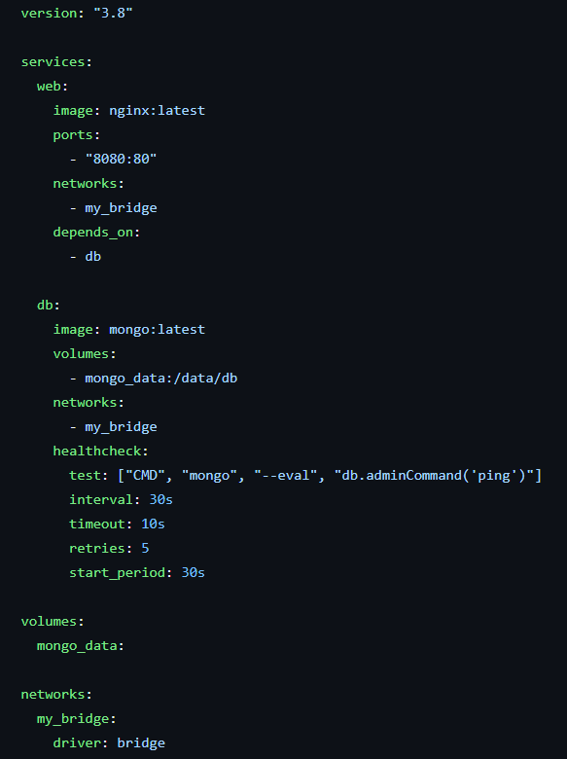


Docker Compose
Networks: Isolated bridge network.
Healthchecks: Auto-restart unhealthy DB.
Volumes: Persistent MongoDB data.

Slide 11
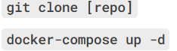
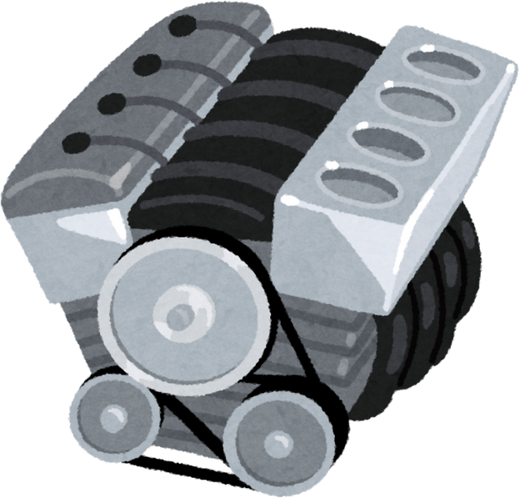
What You Built:
Nginx web server + MongoDB.
Named volume for data persistence.
Replication Steps:
Hands-on Lab Overview
sprints project git
Use .dockerignore.
Avoid latest tags in production.
Scan images for vulnerabilities.
Best Practices

Slide 12
Key Takeaways
Why Containers?
Faster deployments, efficient resource use.
When to Use VMs?
Strong isolation, kernel customization.
Thanks
Docker Docs: docs.docker.com

